Slide 1
A Fresh Look at Referenced-Based Pricing to Drive Affordability
June 9, 2022

Slide 2



Speakers
Michael Thompson
Moderator
National Alliance of Healthcare Purchaser Coalitions
Peter Hayes
Healthcare Purchaser Alliance of Maine
Lawrence Thompson
Advanced Medical Pricing Solutions (AMPS)

Slide 3
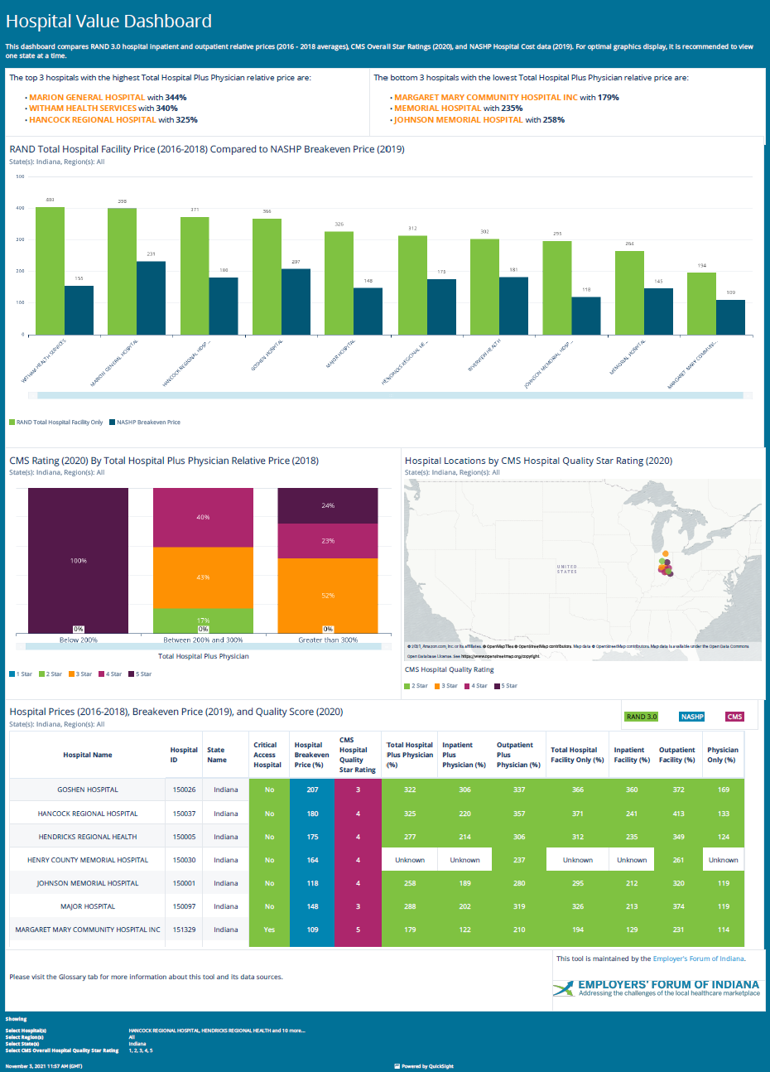
Hospital Price Transparency
Sage Transparency
Hospital Value Dashboard
https://dashboard.sagetransparency.com
April 5 – NASHP Hospital Reporting Tool
  8+ Year trend
  Hospital Break Even By “Market”
  % Medicare Break Even
  Commercial Break Even
May 5 – Hospital Value Dashboard
  RAND 4.0 published April 2022
  NASHP Highlights
  Sample Turquoise Health Results
  CMS Star Ratings
  Healthcare BlueBook Quality Ratings
July 1 – Plan Sponsor CAA Transparency Compliance

Slide 4
Highlights of RAND 4.0 vs NASHP Commercial Breakeven
State | Total Facility Plus Physician (% Medicare) | Total Facility (% Medicare) | NASHP Breakeven Price (% Medicare) | TOTAL FACILITY PRICE/NASHP BREAKEVEN
Alabama | 235 | 246 | 100 | 2.46
Alaska | 278 | 260 | 111 | 2.34
Arizona | 292 | 313 | 132 | 2.37
Arkansas | 149 | 153 | 100 | 1.53
California | 286 | 307 | 182 | 1.69
Colorado | 288 | 310 | 158 | 1.96
Connecticut | 219 | 225 | 131 | 1.72
Delaware | 284 | 322 | 161 | 2
District of Columbia | 244 | 260 | 155 | 1.68
Florida | 309 | 345 | 148 | 2.33
Georgia | 288 | 314 | 122 | 2.57
Hawaii | 147 | 144 | 82 | 1.76
Idaho | 240 | 254 | 118 | 2.15
Illinois | 253 | 273 | 148 | 1.84
Indiana | 292 | 329 | 161 | 2.04
Iowa | 198 | 198 | 101 | 1.96
Kansas | 290 | 315 | 91 | 3.46
Kentucky | 212 | 230 | 127 | 1.81
Louisiana | 230 | 249 | 104 | 2.39
Maine | 275 | 296 | 123 | 2.41
Maryland |  |  | 73 | 0
Massachusetts | 179 | 182 | 101 | 1.8
Michigan | 193 | 203 | 104 | 1.95
Minnesota | 297 | 286 | 120 | 2.38
Mississippi | 193 | 198 | 109 | 1.82
Missouri | 255 | 277 | 128 | 2.16
Montana | 239 | 258 | 80 | 3.23
State | Total Facility Plus Physician (% Medicare) | Total Facility (% Medicare) | NASHP Breakeven Price (% Medicare) | TOTAL FACILITY PRICE/NASHP BREAKEVEN
National | 248 | 260 | 127 | 2.05
Nebraska | 282 | 299 | 100 | 2.99
Nevada | 260 | 285 | 111 | 2.57
New Hampshire | 218 | 237 | 133 | 1.78
New Jersey | 217 | 235 | 145 | 1.62
New Mexico | 288 | 313 | 153 | 2.05
New York | 263 | 278 | 109 | 2.55
North Carolina | 266 | 280 | 149 | 1.88
North Dakota | 211 | 212 | 76 | 2.79
Ohio | 278 | 300 | 133 | 2.26
Oklahoma | 195 | 208 | 124 | 1.68
Oregon | 221 | 223 | 143 | 1.56
Pennsylvania | 235 | 254 | 120 | 2.12
Rhode Island | 194 | 200 | 129 | 1.55
South Carolina | 321 | 351 | 151 | 2.32
South Dakota | 218 | 225 | 99 | 2.27
Tennessee | 219 | 226 | 132 | 1.71
Texas | 252 | 271 | 135 | 2.01
Utah | 198 | 204 | 137 | 1.49
Vermont | 215 | 215 | 109 | 1.97
Virginia | 279 | 306 | 169 | 1.81
Washington | 174 | 176 | 147 | 1.2
West Virginia | 317 | 347 | 137 | 2.53
Wisconsin | 307 | 292 | 138 | 2.12
Wyoming | 305 | 312 | 138 | 2.26

Slide 5
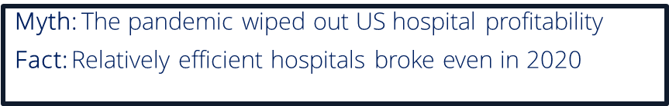
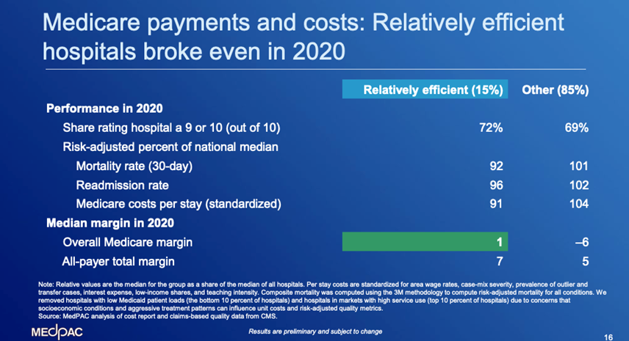
Getting to “Fair Price”
MedPAC 2019 Highlights
A relatively efficient hospital can manage close to Medicare on average
Low margins on Medicare patients can result from a high-cost structure
Lack of market pressure is more common in markets where a few providers dominate and have negotiating leverage over payers
Medicare payment policy should not be designed simply to accommodate whatever level of cost growth a sector demonstrates.

Slide 6
Self-funded Plan Sponsors as Fiduciaries
Fiduciaries have a responsibility to “act solely in the interest of plan participants and their beneficiaries and with the exclusive purpose of providing benefits to them.”
Department of Labor
How can self-funded plans fulfill fiduciary obligations….?
without knowing prices
when hospitals exercise monopolistic pricing
when costs of treatments exceed affordability of both patients and purchasers

Slide 7
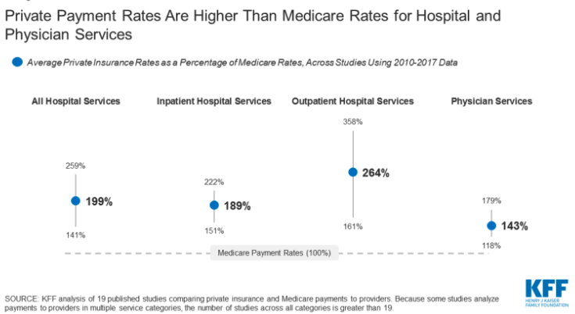
The Fiduciary Dilemma
Prices Both High and Highly Variable
Not Market Driven
CAA reinforces that fiduciaries should pay a fair price for services provided
RAND and NASHP data suggest some health systems are charging well beyond “fair price”
Key contributors to hospital costs
  Consolidation leading to less or no competition
  Lack of transparency
  Anti-competitive practices
Can Reference Based Pricing help to mitigate a “market” stalemate & ensure a fair price?

Slide 8

Reference Based Pricing
June 9, 2022

Slide 9

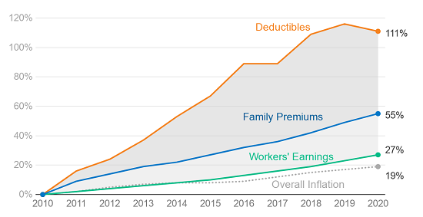
DEDUCTIBLES AND PREMIUMS RISING FASTER THAN WAGES
Cumulative Increases
NOTE: Average general annual deductibles are for single coverage. Workers in plans without a general annual deductible for in-network services are assigned a value of zero.
Source: KFF Employer Health Benefits Survey, 2020; Kaiser/HRET Survey of Employer-Sponsored Health Benefits, 2010 and 2015. Available at: https://www.kff.org/health-costs/report/2020-employer-health-benefits-survey/.
As found in: Gloria Sachdeve and Chris Whaley, “Hospital Price Transparency Study: Aligning Payment with Value,” Employers’ Forum of Indiana, December 14, 2020. Available at: https://employersforumindiana.org/media/formidable/8/MASTER-DECK-on-RAND-3.0-National-Hospital-Price-Transparency-Study.pdf.

Slide 10
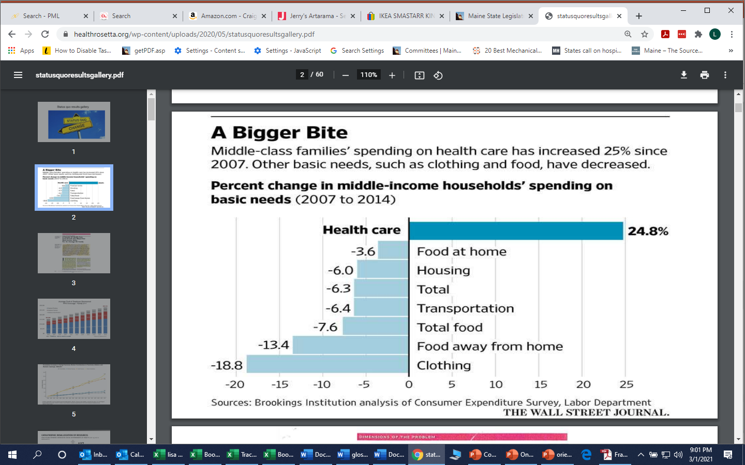
Impact on State Funding
SPENDING ON HEALTH CARE CROWDS OUT OTHER PRIORITIES
Impact on Family Budgets
State of Massachusetts Funding: 2001–2014
+37% healthcare spending
-50% Local Aid
-31% Public Health
-22% Mental Health
-14% Infrastructure, Housing, & Econ. Dev.
-13% Law & Public Safety
-12% Education
-11% Human Services
“Twenty years of wage stagnation on the middle class has been 95% caused by exploding healthcare costs.”
Source: Anna Louie Sussman, “Burden of Health-Care Costs Moves to the Middle Class,” Wall Street Journal, August 25, 2016. Available at: https://www.wsj.com/articles/burden-of-health-care-costs-moves-to-the-middle-class-1472166246 and Dave Chase, “Economic Development 3.0: Playing the Health Car,” January 2017. Available at: https://www.linkedin.com/pulse/economic-development-30-playing-health-card-dave-chase/.
Source: Dave Chase, “Unleashing the American Dream by Thwarting the Healthcare Heist,” Health Rosetta, January 2017. Available at: https://www.linkedin.com/pulse/economic-development-30-playing-health-card-dave-chase/.

Slide 11
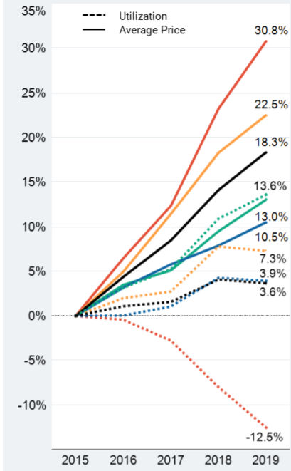
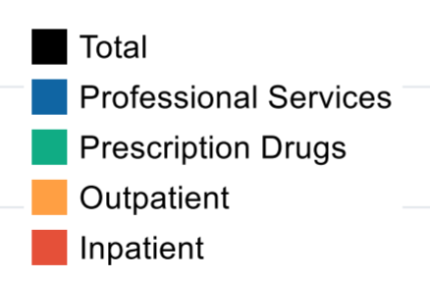
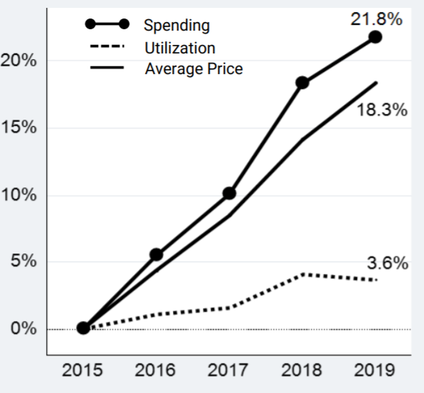
PRICE, NOT UTILIZATION, DRIVING COSTS
Cumulative Change in Spending per Person,
Utilization, and Average Price
Cumulative Change in Spending per Person,
Utilization, and Average Price by Service Category
Price
Utilization
Source: Health Care Cost Institute, 2019 Health Care Cost and Utilization Report. Available at: https://healthcostinstitute.org/images/pdfs/HCCI_2019_Health_Care_Cost_and_Utilization_Report.pdf..

Slide 12
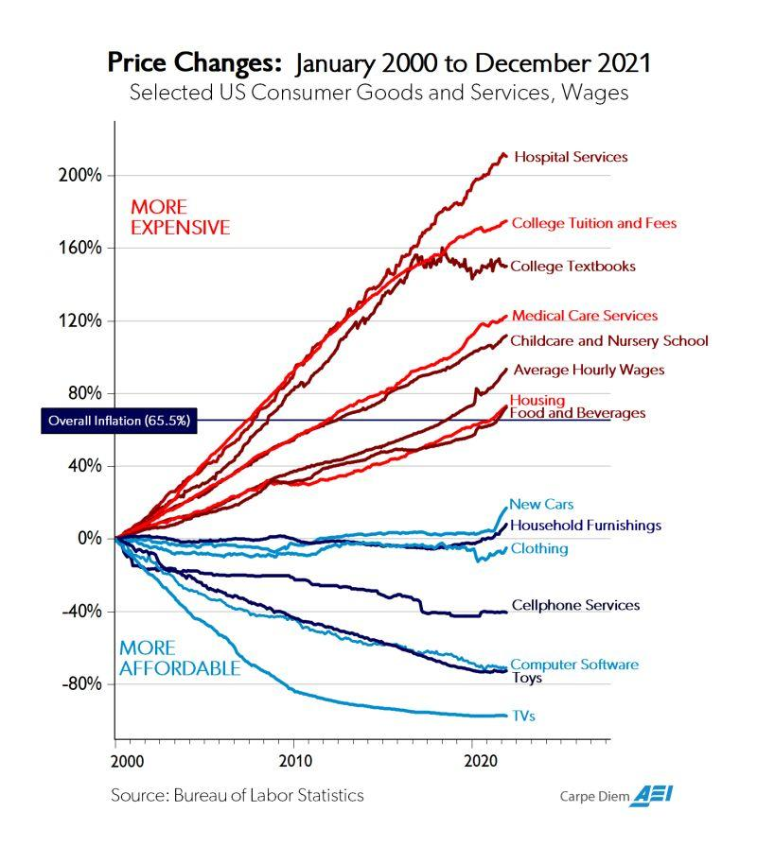
Price Changes: 2000-2021
Takeaway: Markets with quality transparency and competition create higher value
12

Slide 13
REFERENCE-BASED PRICING OVERVIEW
A SOLUTION?

Slide 14
REFERENCE-BASED PRICING
To more easily compare hospitals’ commercial prices, some entities are starting to consider reference-based pricing (RBP), which converts hospital prices to percentages of Medicare
Why Medicare?
  Largest purchaser
  Transparent, publicly available rate-setting process
  Includes adjustments for patient acuity, geographic market, intensity of services, percent of medically underserved, teaching hospital status, etc.
The American Hospital Association claims Medicare reimbursements cover only 87 percent of Medicare costs, suggesting 115 percent of Medicare would be break-even²
COMMERCIAL PRICE
MEDICARE PRICE
COMMERCIAL AS % OF MEDICARE
$5,000
$2,000
($5,000 ÷ $2,000) = 250%

Slide 15
PATHWAYS TO RBP
Some large employers have begun to execute RBP contracts directly with hospitals
  Montana implemented reference based-pricing for its state employee health plan, executing direct contracts with all hospitals in that state that set reimbursement at 220–245 percent of Medicare³
  Other state employee health plans and purchasing alliances are exploring similar direct contracting strategies
Some employers work with RBP vendors who pay hospitals a set percentage of Medicare, which ranges from 120–190 percent, depending on the vendor
  As RBP vendors do not contract with hospitals, such vendor-based programs occasionally result in balance billing, where the hospital bills the patient for any charges not covered by the RBP payment; RBP vendors manage balance bills for impacted patients
  Several RBP vendors are starting to execute RBP contracts directly with hospitals to avoid balance billing
Many organizations implement RBP alongside traditional plans to minimize disruption, but employees overwhelmingly move to the RBP option when given the choice

Slide 16
RAND 3.0 PRICES AND QUALITY: MAINE HOSPITALS 2016–2018
Among Maine’s non-critical access* hospitals, prices ranged from 219 percent to 360 percent of Medicare.
Quality among Maine hospitals is not correlated with price.
Note: Prices are a percent of Medicare (2016-2018). 10/18 CMS Star Ratings
*Critical access hospitals (CAHs) are rural hospitals with 25 or fewer inpatient beds located more than 35 miles from another hospital. Maine has 16 CAHs. Because CAHs are already reimbursed by
Medicare on a “reasonable cost” basis, they presumably have less to make up from commercial purchasers to cover costs.

Slide 17

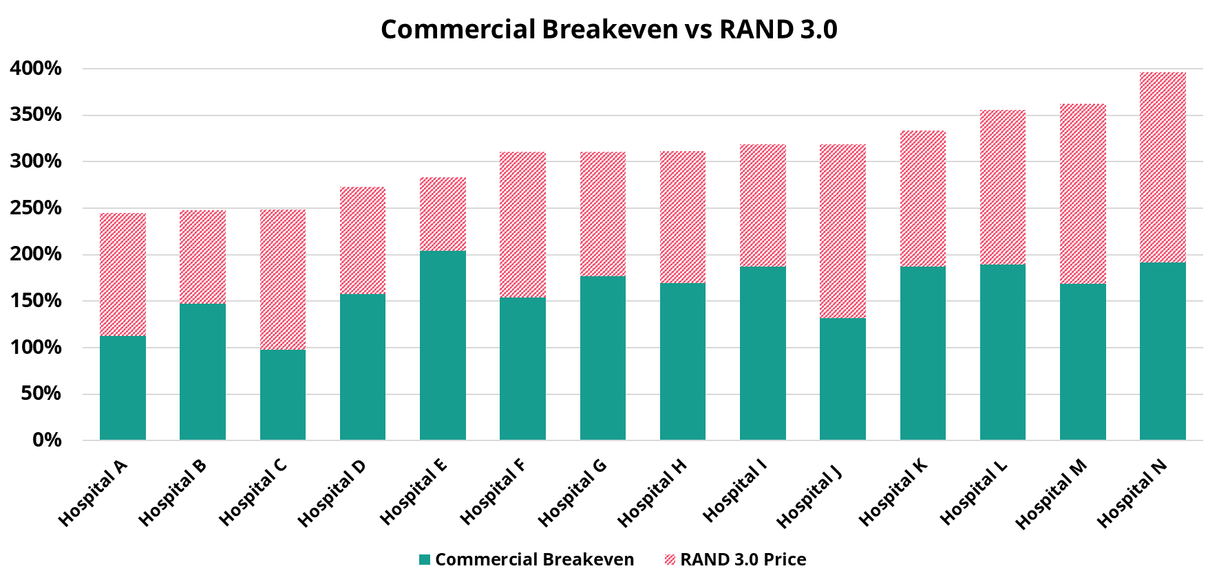
NASHP BREAKEVEN LEVELS & RAND 3.0: SELECT MAINE HOSPITALS
Source: NASHP, Understanding Hospital Costs. Available at: https://www.nashp.org/hospital-cost-tool/.
Notes: Breakeven percentages calculated using NASHP hospital cost tool, populated with 2019 hospital-reported data to CMS. RAND percentages (from RAND 3.0) cover 2016-2018 and are facility only; professional costs are excluded as the NASHP cost tool is based on facility charges only. Critical access hospitals are excluded, as well as three non-CAH hospitals for which additional information is pending.

Slide 18
REFERENCE-BASED PRICING OVERVIEW
THE WHY

Slide 19
RAND 3.0 PROFESSIONAL AND FACILITY PRICES: MAINE HOSPITALS
 | Hospital A | Hospital B | Hospital C | Hospital D | Total HPA BoB
Total Facility Allowed | $53,758,697 | $54,007,289 | $31,311,761 | $120,542,777 | $259,620,524
Savings at Different Medicare Levels
200% of Medicare | -$24,057,759 | -$20,146,920 | -$11,175,580 | -$43,023,306 | -$98,403,566
225% of Medicare | -$20,345,142 | -$15,914,374 | -$8,658,558 | -$33,333,372 | -$78,251,446
250% of Medicare | -$16,632,525 | -$11,681,827 | -$6,141,535 | -$23,643,439 | -$58,099,326
275% of Medicare | -$12,919,908 | -$7,449,281 | -$3,624,513 | -$13,953,505 | -$37,947,206
300% of Medicare | -$9,207,291 | -$3,216,735 | -$1,107,490 | -$4,263,571 | -$17,795,087
Facility Price as % of Medicare (RAND) | 362% | 319% | 311% | 311%
Breakeven (NASHP) | 175% | 172% | 153% | 192%
DRAFT: FOR INTERNAL HPA USE ONLY
Notes: Total facility costs are total allowed amounts based on 2019 incurred claims for purchaser members in HPA’s book of business.
Facility price as a percent of Medicare are RAND 3.0 facility-only data from 2016-2018.
Breakeven percentages are from NASHP’s hospital cost tool, based on Medicare cost reports from 10/1/18-9/30/19 (EMMC & Maine Med) and 7/1/18-6/30/19 for CMMC & MaineGeneral.

Slide 20
RBP: MEETING FIDUCIARY DUTY AND LOWERING PATIENT COSTS
- HEALTH PLAN -
RBP helps purchasers meet their fiduciary responsibility to pay only reasonable plan expenses, by rationalizing payments to hospitals using Medicare reimbursement as a benchmark
Transitioning from a discount off charges methodology to a system that reimburses hospitals based on a reasonable percent of Medicare can remove unwarranted price variation and lower costs for employees
And when RBP reduces employer health costs, they often use those savings to lower employee premiums and cost-sharing, or to increase wages or add other benefits, such as tuition assistance, loan forgiveness, etc.
When plans move to more rational payment models and more reasonable prices, they lower costs; vendor-based RBP programs typically reduce employers’ overall medical spend by 20–30 percent
Fiduciary duty met
Predictable prices
20-30% spend reduction
- EMPLOYEE -
Decreased coinsurance
Decreased premium
Open network

Slide 21
KEY TAKE-AWAYS
Current payment models are not transparent and result in unwarranted price variation, which poses a fiduciary risk to employers
Employers around the US are increasingly using Medicare benchmarks to set reasonable reimbursements for hospitals (120-200%), based on hospitals’ own cost reports.
RBP generates significant savings for both patients and the employer while ensuring hospitals maintain the financial resources necessary to provide community ca

Slide 22


Reference Based Pricing (RBP)
National Alliance Webinar Series
Presented by:
Lawrence Thompson
Chief Revenue & Strategy Officer
Advanced Medical Pricing Solutions

Slide 23

Why Reference Based Pricing?
Most providers claim they lose money at Medicare and Medicaid pricing levels
Providers overcharge private payers to make up the difference
This is called Cost Shifting
True RBP pricing uses many data sources to ascertain the “real “ price for procedures
RBP pays at that price and providers can accept or decline
On average about 95% of all true RBP payments are accepted and 5% are balance billed
The best RBP vendors blend the lower accepted rates with the small number of higher negotiated rates to drive massive claim savings annually.
20%+ over a normal PPO
23

Slide 24


Background on Reference Based Pricing
Developed in 2004 as a ‘Pay and Defend’ Model
There are 20+ vendors in the space
Two of the vendors control over 50% of market share – the most experienced
RBP has matured and is now a nationally recognized cost management tool
RBP can be used in many ways – customized to each client
Two Primary Models:
Medicare Repricing – benchmark to a percentage of Medicare prices
True Reference Based Pricing – multi source fair price model with services
24

Slide 25
RBP Adoption
RBP has been growing in popularity since 2004
Started with primarily small groups (<100 lives)
RBP was primarily sold by small innovative brokers
Over time it has proven the best cost savings tool – highest ROI for a plan
Today RBP is very mainstream and utilized for larger groups (1000+lives)
RBP is now being used by select carriers, large associations, and health sharing orgs
RBP is sued on approximately 4-5% of all claims but expected to be at 15-20% in 24 months
Today RBP is sold by all the major brokers in the US
25

Slide 26
Different RBP Models
Medicare Repricing
True Reference Based Pricing
Medicare Repricing Model
Select a % of Medicare and pay to that
Make payment and wait for pushback
Provide plan defense as an option
Not a Fiduciary to the health plan
Usually, a full PPO replacement model
Typically, one size fits all
True Reference Based Pricing
Start by reviewing all large claim bills
  Remove errors; bundling; do clinical review
  Usually results in 8-12% savings – 90% of bills
Utilize several valid pricing references
  Establish fair price for service
  Pay and defend as a plan fiduciary
Offer several versions of RBP
Provide full member service & advocacy
26

Slide 27
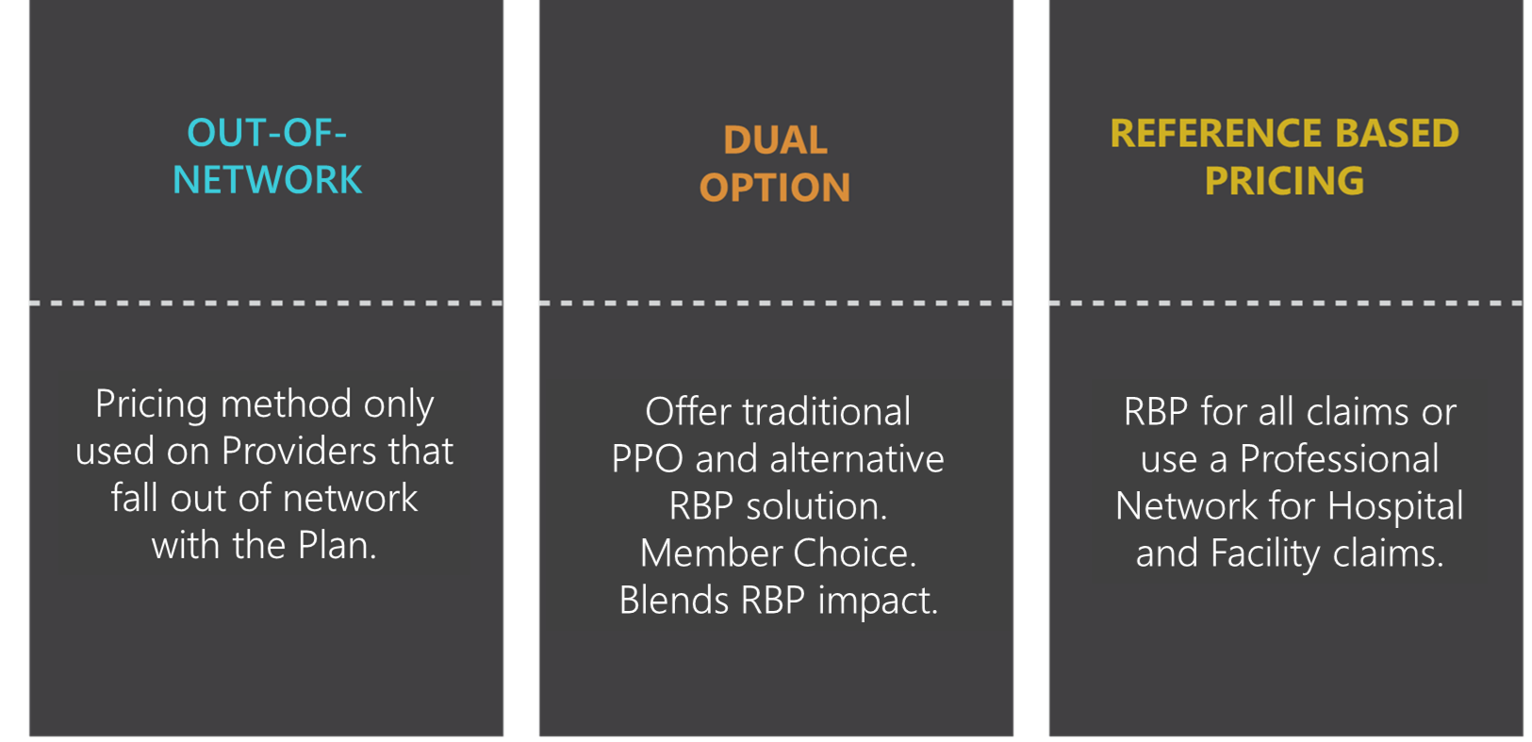
RBP Plan Options and Strategies
There are several RBP options for clients to chose from:
27

Slide 28




Not All RBP Solutions are Created Equal
RBP is a benefit approach that self-funded Health Plans utilize as a cost management tool and as an alternative to a traditional PPO.
RBP relies on ERISA: In the absence of a contracted rate, Health Plans are only required to reimburse at a fair and reasonable level.
RBP has become a catch all for a variety of claim pricing processes. Not all RBP is the same and can provide very different results.
RBP should be a balance between getting the lowest cost, while limiting any employer/member abrasion.
28

Slide 29



Plan Design
RBP does require some plan language changes
ERISA plans allow for these and True RBP vendors can provide them
Since RBP can be used in many formats the design variations are numerous
Your RBP vendor should be able to walk through each and explain expected results
Always get a comprehensive savings analysis based on your plans claims
Member education is the most critical part of a successful RBP program
  Education on what to expect, how to manage, and where to get support
  Correcting myths about Reference Based Pricing to alleviate fears
29

Slide 30
There are typically two ways RBP services are priced:
As a percentage of Gross Billed Charges (GBC)
As a PEPM fee
RBP Pricing
Methodology
GBC is used by clients who only want to pay
when savings are derived – no upfront costs
PEPM is used for clients who want a fixed cost
annually based on enrollment
A % of savings is not used because a Fiduciary
cannot be paid where there is a performance
incentive
The majority of RBP services are sold as a PEPM
Make sure to compare services – low costs
eliminate critical services
30

Slide 31

What about Balance Billing?
#1 FEAR OF USING RBP = BALANCE BILLING
Why a Plan Shouldn’t Worry
True RBP protects against Balance Billing and clients can chose their tolerance levels
True RBP offers full member Advocacy and Legal support
Successful RBP is about balancing savings vs. member abrasion
True RBP offers a variety of plans to manage this balance, based on client needs
Balance bills occur less frequently than most think but vary around the country
Service denial is another fear but can be eliminated by strong Care Navigation
31

Slide 32
Typical Member Experience Pathways
RBP for Facility + Primary Network
Full RBP (no network)
1
Member uses primary network to access providers to find provider
1
Member calls doctor to make an appointment; If they ask what type of insurance the member has, the member will say they have Employer-based coverage and can show their ID card upon arrival
2
Member shows Provider ID card with logo at time of visit
2
If any issues, member should have provider’s office call the administrator’s number on the back of the ID card
3
If any issues, member should have provider’s office call the administrator’s number on the back of the ID card
3
Care given; Claim generated, and member receives EOB; In the rare occurrence of a balance bill (less than 95% of the time); members will call their TPA and warm transfer the members to an AMPS Member Advocate.
4
Care given; Claim generated, and member receives EOB; Less than 0.005% result in any type of pushback or balance billing

Slide 33





Member Education and Support
EDUCATION
CONNECTION
Open Enrollment, Training and Education
Proactive contact with Members
SUPPORT
FREQUENCY
Availability to
assist Members with
questions/concerns
Ongoing training and communication to keep members informed
33

Slide 34
Discussion
Michael Thompson
Moderator
National Alliance of Healthcare Purchaser Coalitions
Peter Hayes
Healthcare Purchaser Alliance of Maine
Lawrence Thompson
Advanced Medical Pricing Solutions (AMPS)

Slide 35


Upcoming Webinars & Events
2022 Leadership Summits: June 27–28
The New Hybrid Workplace Built on Resilience
July 14| 1:00 p.m.- 2:00 p.m. (EDT)
The Mental Health Index Webinar
July 22| 12:00 p.m.- 12:30 p.m. (EDT)
Better Health Now: Relooking at Primary Care Strategy
July 22| 1:00 p.m.- 2:00 p.m. (EDT)

